Slide 1
Predicting a Pitcher’s Performance with Linear Regression
By Nadine Burgos and Sheng Xi Chen
Presented on April 24, 2020

Slide 2


Agenda
1
2
3
Abstract
Introduction
Materials
4
5
Methods
6
8
What Did We Find Out?
What Does This All Mean?
Works Cited
9
Appendix
7
Acknowledgments

Slide 3
Abstract
Baseball is undergoing an “analytic revolution,” where the game has shifted as teams look to improve players based on gathered personal statistics, resulting in what appears to be the new trend of pitchers throwing harder than before. In using linear regression and comparing the ERA of pitchers in 2016 to their average fastball speed, we can conclude whether data supports this new trend of pitchers throwing harder. The conclusion is that fastball speed does have a statistically significant impact on performance; however, with an adjusted R² of 8.25%, the model shows that there are more factors than just a fastball speed that contributes to being a good pitcher overall.

Slide 4

Introduction
The approach to baseball has changed from a game that involves base hits or bunts, also known as “small ball,” to a game where players are going for home runs. Conversely, pitchers are going for more strike outs to curtail the effect of the new style being played. The cause of this evolution is the use of real-time data that has changed the way teams can assess their athletes and provide support for players to perform at higher levels. With the MLB accessing StatCast in 2007, baseball has changed to a game where the performance of an individual is more valued than the actual result of a win or loss for the team. The “analytic revolution” of baseball can be seen in numerous ways. Today, analysts can predict injuries to pitchers using the minute differences in pitch velocity and spin rate. Batters can check their “launch angle” and “exit velocity” at the dugout after finishing batting. Outfielders can check a piece of paper to see exactly where to stand for each batter based on that batter’s spray chart. Lastly, pitchers are being trained to throw harder than ever before to combat the rising quality of batters.
Likewise, much of the data that teams use can be gathered by the general public for use; any of these points can be checked by anyone. Our focus will be on whether the new trend of pitchers throwing harder than ever before is supported by data? To do so, we will use the analytic technique of linear regression to compare the ERA (Earned Run Average) of pitchers in 2016 to their average fastball speed.

Slide 5
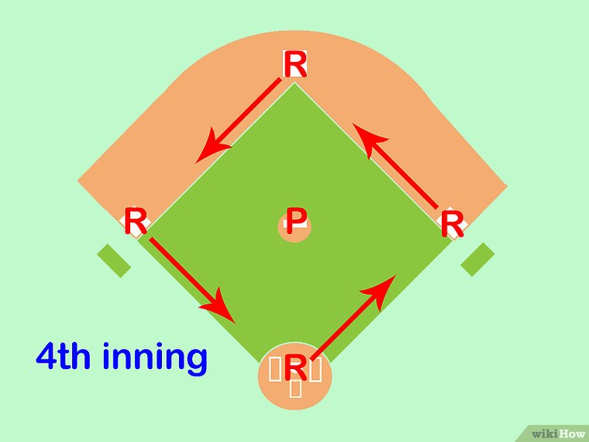
Materials
Two sources of data were used to complete the pitch speed analysis. First was the Lahman Database, which has end of season stats beginning from 1871. Included in the database are statistics that range from pitching to hitting by players from the two current leagues (American and National), the four other “major” leagues (American Association, Union Association, Players League, and Federal League) and the National Association of 1871-1875. Second, was the MLB.com’s PitchF/x data, that has data for every pitch thrown including the type of pitch, the speed, direction and much more.
Why Earned Run Average is used over other variables?
In baseball, the ERA of pitchers is the most used statistic that tracks the number of runs scored against the pitcher per nine innings pitched. For example, a pitcher who allows 3 earned runs in 6 innings pitched would have an ERA of 4.5 (9 × 3/6). A team’s desire is to have a pitcher with a low ERA; meaning that the pitcher is good at preventing runs that can lead to scoring.
Source: https://www.wikihow.com/Calculate-ERA-(Earned-Run-Average)#/Image:Calculate-ERA-(Earned-Run-Average)-Step-8.jpg

Slide 6

Methods
The statistical program of R was utilized. R is a language for statistical computing and graphics that allows for many different techniques like linear modeling to be performed. One of the strengths of R is the high-quality plots that are produced for the user that can be added to publications. It is also available as Free Software for users.
Source: https://commons.wikimedia.org/wiki/File:R_logo.svg

Slide 7
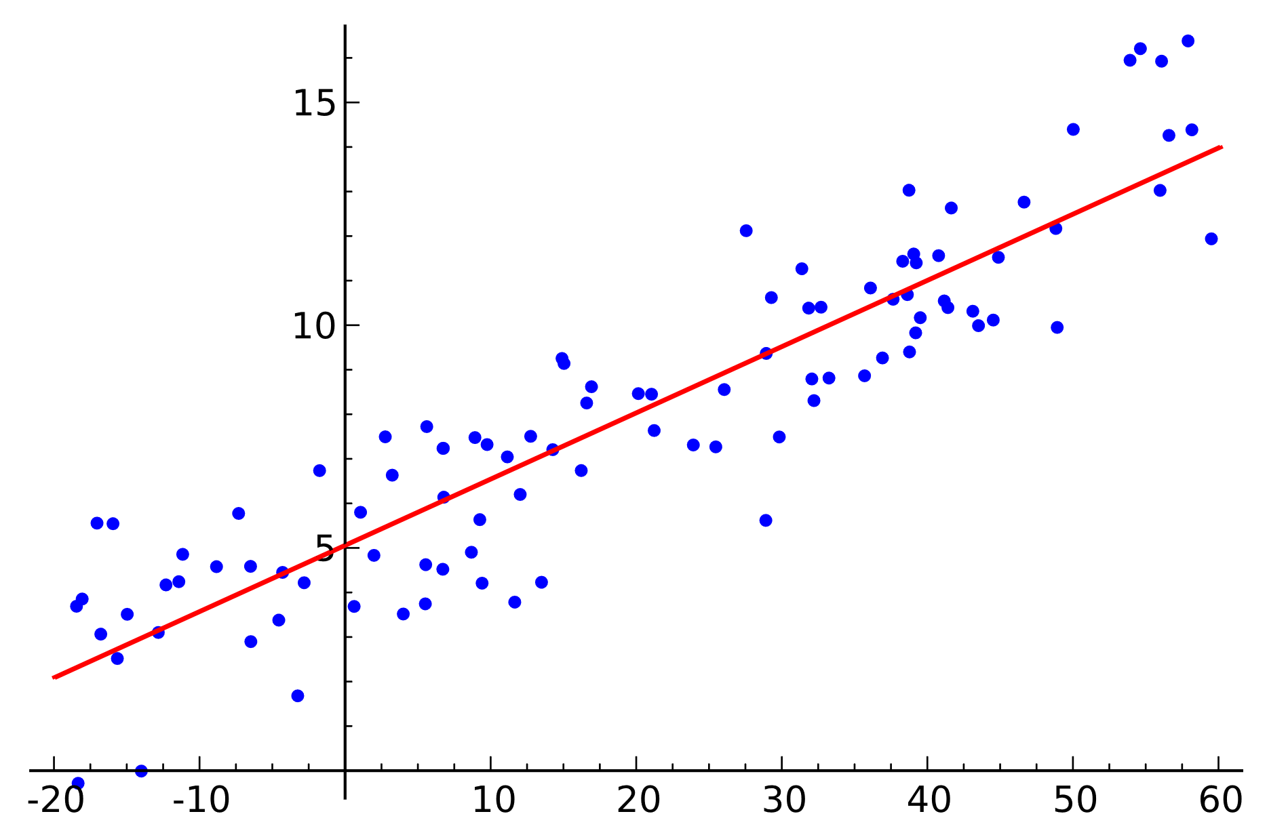
Methods continued
The technique that is being demonstrated is Linear Regression. Linear Regression is used to model the relationship between two variables by fitting a linear equation to the observed data. First, it is important to determine if a relationship between variables of interest exists. There must be some significant association between the two variables, not necessarily causation. No association between the proposed explanatory and dependent variables indicates that fitting a linear regression model to the data will not result in a useful model. The equation of a linear regression line is Y=a+bX, where X is the explanatory variable and Y is the dependent variable. The slope of the line is b, and a is the intercept (the value of y when x = 0).
Example:

Slide 8
What Did We Find Out? (Part 1)
To analyze the pitching data from the MLB’s database in R, we use the “pitchRx” package and “scrape” command. First, we look at the correlation between start speed (when ball leaves the hand) and ERA (Earned Run Average, the lower the better for pitcher striking batters out), which happens to be -0.234668 which is not a strong correlation, but it does show some sort of relationship between speed and ERA. In this case, as speed increases, the ERA tends to decrease.
The best fit line is ERA = 14.90057 – 0.1159(start speed)
Residuals:
Min 1Q Median 3Q Max
-2.2760 -0.8130 -0.0811 0.6954 5.3207
Coefficients:
(Intercept) 14.90057 2.78855 5.343 1.99e-07 ***
start speed -0.11759 0.03021 -3.893 0.000126 ***
Signif. codes: 0 ‘***’ 0.001 ‘**’ 0.01 ‘*’ 0.05 ‘.’ 0.1 ‘ ’ 1 Residual standard error: 1.147 on 260 degrees of freedom
Multiple R-squared: 0.05507, Adjusted R-squared: 0.05143
F-statistic: 15.15 on 1 and 260 DF, p-value: 0.0001261

Slide 9
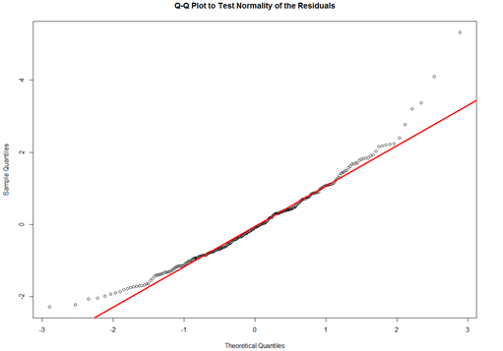
What Did We Find Out? (Part 2)
Given in the previous slide, 0.000126 is the p-value for start speed, which means that the start speed does have a statistically significant impact on ERA.
However, the adjusted R² value is 0.05143. In another words, this linear regression model only covers 5.143% of the data. This tells us that ball speed does impact ERA but does not have a large amount of influence over it.
As you could see, there are a lot of outliers that would be affecting the model. So we will be using the boxplot to identify the outliers and removing them. With the absence of outliers, we will create a new linear regression model.

Slide 10
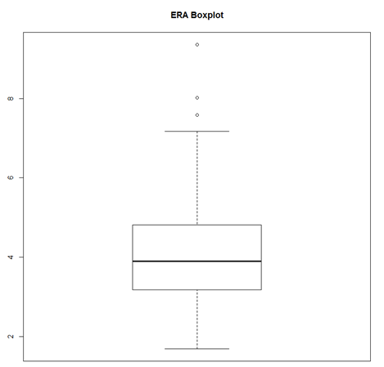
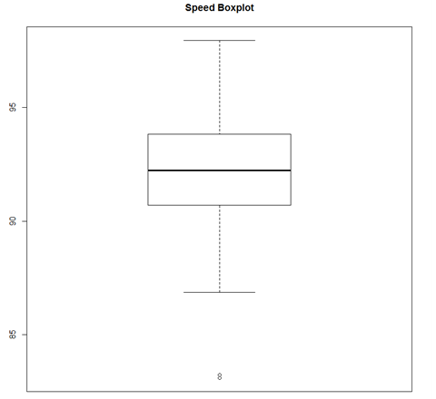
What Did We Find Out? (Part 3)
Above are the box-plots for ERA and Speed of the ball leaving the pitcher’s hand. You can clearly see the outliers, which we will be excluding from our new model.

Slide 11
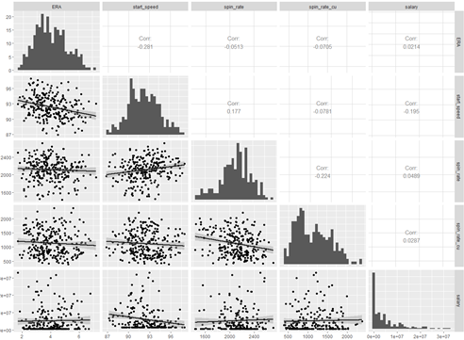
What Did We Find Out? (Part 4)
Our new linear regression model is:
ERA = 16.00280-0.12998(start speed)
This model like the previous one has a low p-value, and an improved adjusted R² of 0.06718 or 6.718%. In other words, our model only explains less than 7% of the data.
In pursuit of an improved model, we utilized the ‘GGally’ package to try to find and add other factors to ERA, such as ball speed, spin rate, breaking point, and salary.
We can now see the following points: 1) Spin rate does influence ERA ; 2) Salary does not have impact and decreases adjusted R² .
Using this we form a new ERA equation to forecast ERA.

Slide 12
What Did We Find Out? (Part 5)
Final equation for predicting ERA:
ERA = 17.876 – 0.143(start speed) – 0.0003309(spin rate)
This equation tells us that the start speed and the spin rate of the ball both contribute to lowering the ERA of the pitcher. As previously mentioned, the small p-value for the start speed shows the speed of the ball being thrown does have a statistically significant impact on the performance of ERA. Likewise, the same goes to the spin rate of the ball. However, the low R² value of 0.0825 shows it doesn’t explain everything in predicting ERA. In other words, start speed is an important factor in predicting ERA, but does not explain all the aspects in accurately predicting ERA.

Slide 13
What does this all mean?
The equation we got for predicting ERA is:
ERA = 17.876-0.143(start speed)-0.000126(spin rate)-0.0003309(spin rate)
Using linear regression is wise here in finding the correlation in different aspects of how the pitcher throws the ball, whether that might be a negative or a positive correlation. In our case, every pitcher desires the lowest ERA possible, and what contributes to that is the speed of the ball leaving the hand and how fast the ball spins. These two variables both have a negative relationship with ERA, as they increase, the ERA decreases.
Of course, this model can be improved further by adding more contributing aspects that would help predict ERA such as the location of the pitches, the variance of speed, pitch selection, spin between pitches, and many others that may have influence on the performance of the pitcher that have not yet been discovered. Overall, being a good pitcher is now seen with throwing balls harder, but the factors that contribute to this new trend include more than just a better start speed as demonstrated in this study.

Slide 14

ACKNOWLEDGMENTS
We would like to recognize Alex Hagen’s work on baseball related statistical analyses as he provided the R code to perform this study. We also like to thank Sean Lahman for creating a Baseball Database that allows for followers of baseball to test problems like the one found in this presentation. Their dedication to the sport of baseball has allowed for many new developments by those who hope for baseball to reach higher levels.
For any more information, please refer to the Works Cited.

Slide 15
Works Cited
Fast, Mike. “Pitchfx Glossary –.” Fast Balls, WordPress, 14 Jan. 2008,
fastballs.wordpress.com/category/pitchfx-glossary.
Hagen, Alex. “Using Linear Regression to Predict a Pitcher's Performance.” CCGAnalytics.com, CCG, 9 Nov. 2017, blog.ccganalytics.com/using-linear
-regression-pitchers-performance.
Lahman, Sean. “Download Lahman's Baseball Database.” SeanLahman.com, WordPress, 2020, www.seanlahman.com/baseball-archive/statistics/.
Lahman, Sean. “The Lahman Baseball Database.” SeanLahman.Com – Baseball, Data, and Storytelling, WordPress, 25 Feb. 2017, www.seanlahman.com/files/database/readme2016.txt.
Powered Template. “Pitcher PowerPoint Template.” PoweredTemplate, Powered Template Limited, 9 May 2006, poweredtemplate.com/01142/0/index.html.
The R Foundation. “R: What Is R?” R-Project.Org, The R Foundation, www.r- project.org/about.html. Accessed 18 Apr. 2020.
Yale University. “Linear Regression.” Yale.Edu, Yale University,
www.stat.yale.edu/Courses/1997-98/101/linreg.htm. Accessed 15 Apr. 2020.

Slide 16
Appendix I
R CODE:
INSTALL.PACKAGES("PITCHRX")
LIBRARY(PITCHRX)
GAME <- SCRAPE(GAME.IDS = "GID_2017_07_19_TBAMLB_OAKMLB_1")
GAMES_APRIL <- SCRAPE("2016-04-03","2016-04-15")
PITCHES_APRIL <- PLYR::JOIN(GAMES_APRIL$ATBAT, GAMES_APRIL$PITCH, BY=C("NUM", "URL"), TYPE="INNER")
GAMES_APRIL_2 <- SCRAPE("2016-04-16","2016-04-28")
PITCHES_APRIL_2 <- PLYR::JOIN(GAMES_APRIL_2$ATBAT, GAMES_APRIL_2$PITCH, BY=C("NUM", "URL"), TYPE="INNER")
PITCHES_ALL <- PLYR::JOIN(PITCHES_APRIL, PITCHES_APRIL_2, TYPE = "FULL")
SETWD(“#MY FOLDER#")
PITCHING_STATS <- READ.CSV("PITCHING.CSV"
PITCHING_STATS <- SUBSET(PITCHING_STATS, PITCHING_STATS$YEARID == 2016)
MASTER <-READ.CSV("MASTER.CSV")
MASTER <- SUBSET(MASTER, SELECT = C("PLAYERID","NAMEFIRST","NAMELAST"))
MASTER$PITCHER_NAME <- PASTE(MASTER$NAMEFIRST, MASTER$NAMELAST, SEP=" ")
PITCHING_STATS_WITH_NAMES <- PLYR::JOIN(PITCHING_STATS, MASTER, BY= "PLAYERID", TYPE="INNER")
PITCHES_ALL_AND_STATS <- PLYR::JOIN(PITCHING_STATS_WITH_NAMES, PITCHES_ALL, BY= "PITCHER_NAME", TYPE="INNER")
PITCHES_ALL_AND_STATS <- SUBSET(PITCHES_ALL_AND_STATS , STINT == 1)
PITCHES_ALL_AND_STATS <- SUBSET(PITCHES_ALL_AND_STATS, IPOUTS >= 150)
PITCHES_FASTBALLS_AND_STATS <- SUBSET(PITCHES_ALL_AND_STATS, PITCH_TYPE %IN% C("FA", "FF", "FT"))
PITCHES_FASTBALLS_AND_STATS <- SUBSET(PITCHES_FASTBALLS_AND_STATS, SELECT = C("PITCHER_NAME","START_SPEED","ERA"))
PITCHERS_FASTBALLS_ERA <- AGGREGATE(PITCHES_FASTBALLS_AND_STATS[,2:3], LIST(PITCHES_FASTBALLS_AND_STATS$PITCHER_NAME), MEAN)
COLNAMES(PITCHERS_FASTBALLS_ERA)[COLNAMES(PITCHERS_FASTBALLS_ERA)=="GROUP.1"] <- "PITCHER_NAME“
COR(PITCHERS_FASTBALLS_ERA$ERA,PITCHERS_FASTBALLS_ERA$START_SPEED)
LM_ERA <- LM(FORMULA = ERA ~ START_SPEED, DATA = PITCHERS_FASTBALLS_ERA)
SUMMARY(LM_ERA)
INSTALL.PACKAGES("GGPLOT2")
LIBRARY(GGPLOT2)
GGPLOT(PITCHERS_FASTBALLS_ERA,
AES(X = `START_SPEED`, Y = `ERA`)) + GEOM_POINT() + THEME(PANEL.BORDER = ELEMENT_RECT(COLOR = "BLACK", FILL = NA, SIZE = 1), PANEL.BACKGROUND = ELEMENT_RECT(FILL = "WHITE"), PANEL.GRID.MAJOR = ELEMENT_LINE(COLOR = "GREY", LINETYPE = "DASHED")) + STAT_SMOOTH(METHOD = "LM", COLOR = "ORANGE", SIZE = 1, LEVEL = 0.95)
LM_ERA_RESID <- AS.DATA.FRAME(LM_ERA$RESIDUALS)
PLOT(DENSITY(LM_ERA$RESIDUALS),XLAB = "RESIDUALS", MAIN = "DISTRIBUTION OF RESIDUALS")
QQNORM(LM_ERA$RESIDUALS, MAIN = "Q-Q PLOT TO TEST NORMALITY OF THE RESIDUALS")
QQLINE(LM_ERA$RESIDUALS, LWD = 3, COL = "RED")

Slide 17
Appendix II
R CODE CONTINUED:
BOXPLOT <- BOXPLOT(PITCHERS_FASTBALLS_ERA$START_SPEED, PITCHERS_FASTBALLS_ERA$ERA, MAIN = "FASTBALLS AND ERA BOXPLOT")
ERA_BOXPLOT <- BOXPLOT(PITCHERS_FASTBALLS_ERA$ERA, MAIN = "ERA BOXPLOT")
SPEED_BOXPLOT <- BOXPLOT(PITCHERS_FASTBALLS_ERA$START_SPEED, MAIN = "SPEED BOXPLOT")
BOXPLOT_OUTLIERS_ERA <- PITCHERS_FASTBALLS_ERA[PITCHERS_FASTBALLS_ERA$ERA %IN% BOXPLOT_OUTLIERS[3:5, 1], ]
BOXPLOT_OUTLIERS_SPEED <- PITCHERS_FASTBALLS_ERA[PITCHERS_FASTBALLS_ERA$START_SPEED %IN% BOXPLOT_OUTLIERS[1:2, 1], ]
BOXPLOT_OUTLIERS_ERA_NAMES <- ROWNAMES(BOXPLOT_OUTLIERS_ERA)
BOXPLOT_OUTLIERS_SPEED_NAMES <- ROWNAMES(BOXPLOT_OUTLIERS_SPEED
BOXPLOT_OUTLIERS_NAMES <- C(BOXPLOT_OUTLIERS_ERA_NAMES, BOXPLOT_OUTLIERS_SPEED_NAMES)
GGPLOT(PITCHERS_FASTBALLS_ERA, AES(X = `START_SPEED`, Y = `ERA`)) + GEOM_POINT() + THEME(PANEL.BORDER = ELEMENT_RECT(COLOR = "BLACK", FILL = NA, SIZE = 1),
PANEL.BACKGROUND = ELEMENT_RECT(FILL = "WHITE"), PANEL.GRID.MAJOR = ELEMENT_LINE(COLOR = "GREY", LINETYPE "DASHED")) +STAT_SMOOTH(METHOD = "LM", COLOR = "ORANGE", SIZE = 1, LEVEL = 0.95) + GEOM_POINT(DATA= PITCHERS_FASTBALLS_ERA[BOXPLOT_OUTLIERS_NAMES,], AES(X = PITCHERS_FASTBALLS_ERA[BOXPLOT_OUTLIERS_NAMES, ]$START_SPEED, Y = PITCHERS_FASTBALLS_ERA[BOXPLOT_OUTLIERS_NAMES, ]$ERA), COLOR = "RED", SIZE = 3)
PITCHERS_FASTBALLS_ERA_NO_OUTLIERS <- SUBSET(PITCHERS_FASTBALLS_ERA, !ROWNAMES(PITCHERS_FASTBALLS_ERA) %IN% BOXPLOT_OUTLIERS_NAMES)
GGPLOT(PITCHERS_FASTBALLS_ERA_NO_OUTLIERS, AES(X = `START_SPEED`, Y = `ERA`)) + GEOM_POINT() + THEME(PANEL.BORDER = ELEMENT_RECT(COLOR = "BLACK", FILL = NA, SIZE = 1), PANEL.BACKGROUND = ELEMENT_RECT(FILL = "WHITE"), PANEL.GRID.MAJOR = ELEMENT_LINE(COLOR = "GREY", LINETYPE = "DASHED")) + STAT_SMOOTH(METHOD = "LM", COLOR = "ORANGE", SIZE = 1, LEVEL = 0.95)
COR(PITCHERS_FASTBALLS_ERA_NO_OUTLIERS$ERA,PITCHERS_FASTBALLS_ERA_NO_OUTLIERS$START_SPEED)
LM_ERA_NO_OUTLIERS <- LM(FORMULA = ERA ~ START_SPEED, DATA = PITCHERS_FASTBALLS_ERA_NO_OUTLIERS)
SUMMARY(LM_ERA_NO_OUTLIERS)
INSTALL.PACKAGES("GGALLY")
LIBRARY(GGALLY)
GGPAIRS(PITCHERS_NO_OUTLIERS[,C("ERA","START_SPEED","SPIN_RATE","SPIN_RATE_CU","SALARY")], LOWER = LIST(CONTINUOUS = "SMOOTH"), DIAG = LIST(CONTINUOUS = "BARDIAG"))
MULTIVARIATE_LM_ERA <- LM(FORMULA = ERA ~ START_SPEED + SPIN_RATE + SPIN_RATE_CU, DATA = PITCHERS_NO_OUTLIERS)
SUMMARY(MULTIVARIATE_LM_ERA)

